Slide 1
Supply chain sustainability analysis
Ian Cedric Io
Created in R & Tableau

Slide 2
AGENDA
Problem
Exploratory Data Analysis
Insights
Recommendations

Slide 3
Problem
Which orders should be prioritised?
Issue: High number of item complexity (557 different items)
Tool: Pareto Analysis – according to total value ($) and number of items

Slide 4
Annex: DATA PREPARATION IN R
Order List
"Item.Code" (primary key) "X.x" "Conversion.Ratio" "X.y" "Date" "Month.Year" "Warehouse.Code" "Customer.Code" "Order.Number" "Order.Line.Number" "Units" "Euros" "TotalValue"
GPS Locations
"X" "Country" "City" "GPS.1" "GPS.2"
distances.csv
gps_locations.csv
order_lines.csv
uom_conversions.csv
Distances
"X" "Warehouse.Code" "Warehouse.Name" "Warehouse.Country" "Warehouse.City" "Customer.Code"
"Customer.Country" "Customer.City" "Road" "Rail" "Sea" "Air"

Slide 5
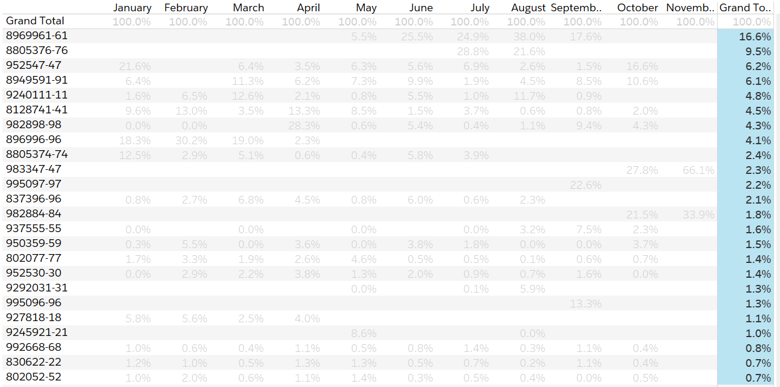
Which items should we prioritize?
Across all months, Class A items represent
79.4% of total value
24 (top 5%) out of 557 items
*However, our analysis would need to be validated with month-to-month breakdown due to seasonality trends

Slide 6
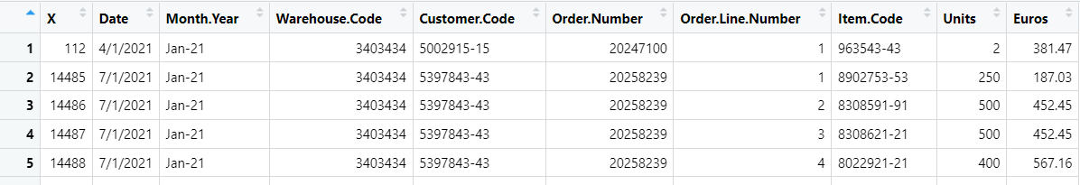
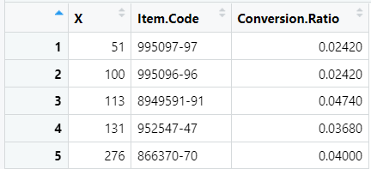
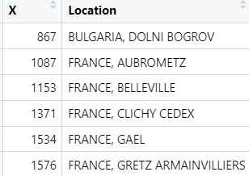
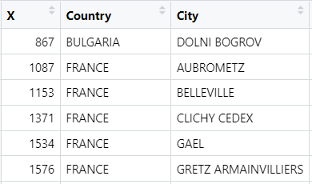
Annex: DATA PREPARATION IN R
Step 1: Merge orders & unit of measure (UOM) conversion into single file
based on item code (item ID)
Step 3: Create a new field for total value based on Quantity * Cost of Goods
# total value of customer order
masterOrder$TotalValue= masterOrder$Units * masterOrder$Euros
Step 2: Split location based on comma (,) separator into two distinct columns – Country & City

Slide 7
PRESENTATION TITLE
Mirjam Nilsson​

Slide 8
AGENDA
Introduction​
Primary goals
​Areas of growth
Timeline
​Summary​

Slide 9
Introduction
At Contoso, we empower organizations to foster collaborative thinking to further drive workplace innovation. By closing the loop and leveraging agile frameworks, we help business grow organically and foster a consumer-first mindset.

Slide 10
PRIMARY GOALS
Annual revenue growth

Slide 11
AREAS OF GROWTH
 | B2B | Supply chain | ROI | E-commerce
Q1 | 4.5 | 2.3 | 1.7 | 5.0
Q2 | 3.2 | 5.1 | 4.4 | 3.0
Q3 | 2.1 | 1.7 | 2.5 | 2.8
Q4 | 4.5 | 2.2 | 1.7 | 7.0

Slide 12
BUSINESS OPPORTUNITIES ARE LIKE BUSES. THERE'S ALWAYS ANOTHER ONE COMING.
“
”
Richard Branson

Slide 13




MEET OUR TEAM
TAKUMA HAYASHI
MIRJAM NILSSON
FLORA BERGGREN​
RAJESH SANTOSHI​
President
Chief Executive Officer
Chief Operations Officer
VP Marketing

Slide 14








MEET OUR Extended TEAM
TAKUMA HAYASHI
MIRJAM NILSSON
FLORA BERGGREN​
RAJESH SANTOSHI​
President
Chief Executive Officer
Chief Operations Officer
VP Marketing
GRAHAM BARNES
ROWAN MURPHY
ELIZABETH MOORE
ROBIN KLINE
VP Product
SEO Strategist
Product Designer
Content Developer

Slide 15





PLAN FOR PRODUCT LAUNCH
PLANNING
MARKETING
DESIGN
STRATEGY
LAUNCH
Synergize scalable e-commerce
Disseminate standardized metrics
Coordinate e- business applications
Foster holistically superior methodologies
Deploy strategic networks with compelling e- business needs

Slide 16
TIMELINE
SEP 20XX
NOV 20XX
JAN 20XX
MAR 20XX
MAY 20XX
Synergize scalable e-commerce
Disseminate standardized metrics
Coordinate e- business applications
Foster holistically superior methodologies
Deploy strategic networks with compelling e- business needs

Slide 17
AREAS OF FOCUS
B2B MARKET SCENARIOS
CLOUD-BASED OPPORTUNITIES
Develop winning strategies to keep ahead of the competition
Capitalize on low-hanging fruit to identify a ballpark value
Visualize customer directed convergence
Iterative approaches to corporate strategy
Establish a management framework from the inside

Slide 18



HOW WE GET THERE
ROI
NICHE MARKETS
SUPPLY CHAINS
Envision multimedia-based expertise and cross-media growth strategies
Visualize quality intellectual capital
Engage worldwide methodologies with web-enabled technologies
Pursue scalable customer service through sustainable strategies
Engage top-line web services with cutting-edge deliverables
Cultivate one-to-one customer service with robust ideas
Maximize timely deliverables for real-time schemas

Slide 19
SUMMARY
At Contoso, we believe in giving 110%. By using our next-generation data architecture, we help organizations virtually manage agile workflows. We thrive because of our market knowledge and great team behind our product. As our CEO says, "Efficiencies will come from proactively transforming how we do business."

Slide 20
THANK YOU
Mirjam Nilsson​
mirjam@contoso.com
www.contoso.com

